Slide 1
Calculating Heat Capacities
Non-linear fitting with Python

Slide 2
Things you’ll need
CheckIn Code: 795244
VLE page: Advanced Skills and Practical 1 > PC Workshops > Kirchoff’s Law
Download and unzip the file “Code_and Data.zip”. This contains:
Four CSV files of thermodynamic data
Two python scripts (test.py and plot.py)
Download and open this powerpoint.
Download all of these into a folder on your M: or H: drive and open that folder in File Explorer. Make sure the .py and .csv files are in the same folder.

Slide 3
Python scripts
These scripts are just text files which contain instructions
We need to run these files using a Python interpreter
Usually need to run with arguments which provide information such as the files to analyse when the script runs
Later, we will add functions and edit variables in the scripts to suit what you want to achieve
Eg. add a new fitting function, set axes labels, choose columns for x and y, whether to include a line of best fit

Slide 4
Python terminology
Variable
Used to store information at one point in the script which can be used later
Comment
Lines prefixed with # are ignored by the script and are used for your own notes
Loop
Instructions which the script does repeatedly: for each item in some list, do some function
Function
A set of instructions for the computer to execute (eg draw graph, label axes)
Libraries
Pre-written code which can imported into our scripts to provide common functions (eg plotting, maths functions, reading files, displaying windows)

Slide 5
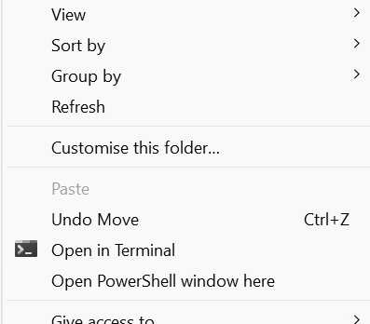

Executing a script
Open the folder containing your python script in File Explorer.
Then open Powershell from the file menu:
Shift + right click
Select “Open Powershell window here”
Check the ‘Working Directory’ is displayed in Powershell.
Write a command that calls the python interpreter, and passes the script name and any arguments:
python3 script.py arguments

Slide 6
Test script
Download the test script (test.py) and move it into your working directory.
This script should run correctly:
python test.py
The script checks you have a working python environment with all the packages installed that we will be using.
Run the test script first when working on a new computer to check the setup!
If this script won’t run, get help to fix your setup…
Is Python installed?
If you are on a campus machine, try another PC

Slide 7
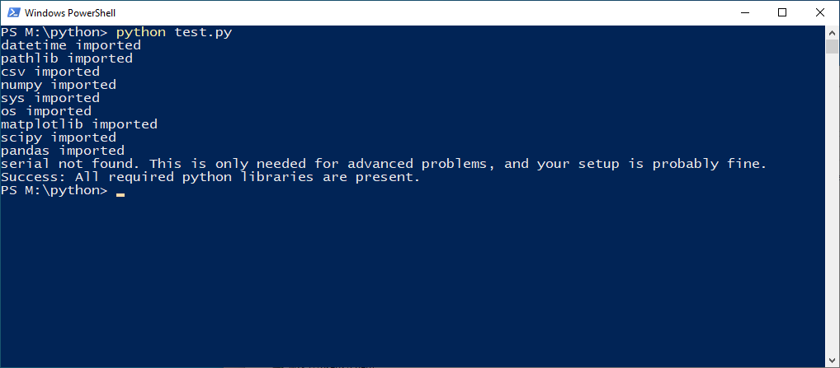
Test script

Slide 8
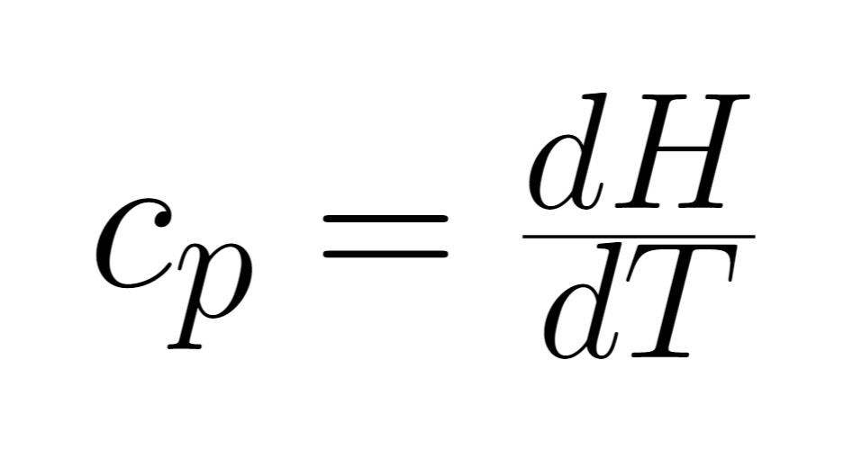
Kirchoff’s Law
We’re going to look at the relationship between enthalpy, temperature, and heat capacity.
We’ll use Python to apply this to some real-world data.

Slide 9
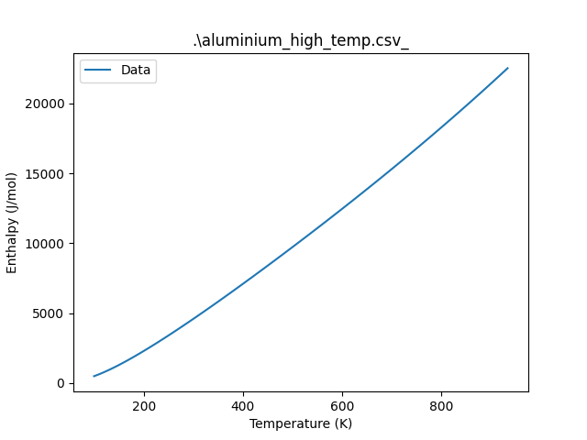
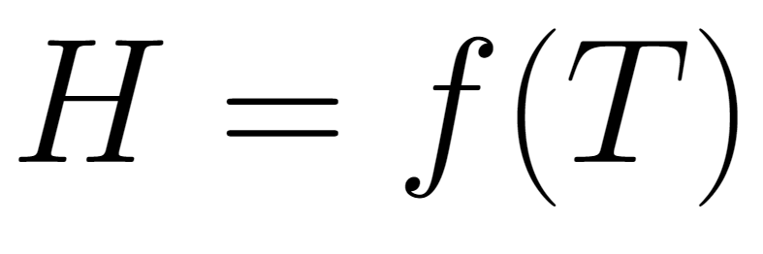
The main idea
We will use the real-world data to plot H against T.
Then we’ll fit the data to find an equation for H in terms of T.
We’ll then differentiate to find an equation for c_{p}.

Slide 10
Steps we’re going to do today
Run the code on experimental “Al at high T” data to produce a simple plot.
Edit the script: correct axis labels and title and rerun the code.
Run the code on “Al at high T” data with a linear fit; calculate the heat capacity of Al.
Evaluate the fit: how to we compare one fit to another?
Run the code with a linear fit on “Al at low T” data.
Define a new function in the code.
Re-run the code with a new fitting function; calculate the heat capacity of Al using differentiation.
What happens with noisy data? Re-run the code on a noisy version of the low T Al data; re-calculate Al’s heat capacity from this data’s fit parameters.
Define a third function with parameters up to 10th power in x and re-run.

Slide 11
Plotting a graph
Download the plot script and the CSV files into your working directory on the H: or M: drive.
Start with running the script and passing an argument of one filename:
python plot.py aluminium_high_temp.csv
The script should run, and will create a graph from the file as a .png ( which gets saved into your working directory, you can access the image in File Explorer).
(Make sure plot.py is in your working directory! This is the folder you’re currently working in. Use the command “ls” (“list the stuff in this directory”) to double-check this.)

Slide 12
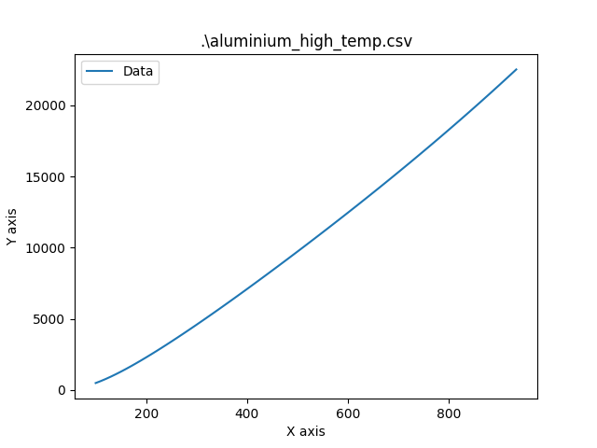
Plotting a graph
When you open the.png in your file explorer, it should look like this.
What’s wrong with this graph?

Slide 13
2. Editing the script
Open the script in a text editor:
Right click the script in your file explorer
Select “Edit with Notepad++”
When we run the script in Powershell, the python interpreter carries out the instructions one by one and outputs the result.
Comments are prefixed with a # and are ignored when the script is run.
There are lots of options to configure (i.e. change to suit your needs) in the script, and these are described by the comments.
We’re going to reconfigure the title and the axis labels to match the data they represent.

Slide 14
2. Editing the script
In Notepad++, find the lines in the code that control what text goes in the title, the X axis and the Y axis.
Change the text between the quotes to set appropriate labels with units, following IUPAC style:
Axis label / units e.g. time / s
And also set a new title which more accurately describes what’s in the figure.
Edit and save the file in Notepad++, then rerun the script in Powershell.

Slide 15
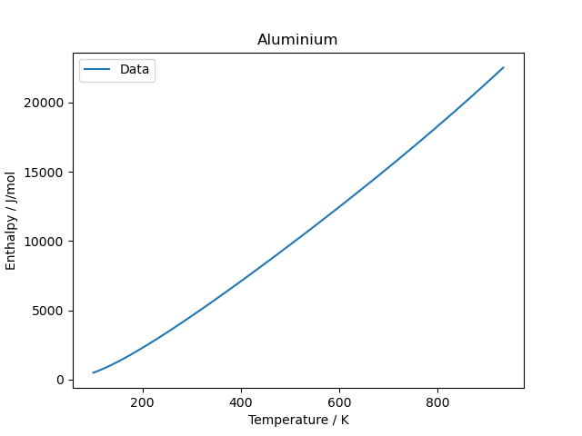
2. Editing the script
This will be saved as a .png, accessible through your file explorer just like before.
Now that the labels on our axes are correct, we can begin to produce some lines of best fit.

Slide 16
3. A linear fit
Now we’re going to run plot.py again, but this time we’re adding a linear line of best fit.
In the script, you’ll see that “linear” is one of the “args” (arguments) that the script can get passed and use to perform logic.
We pass arguments to the python interpreter (which goes on to pass arguments to the script) by including them in our command line arguments:
python plot.py aluminium_high_temp.csv linear
This should produce a new plot with two lines: one showing the raw data, and the other showing the linear line of best fit.

Slide 17
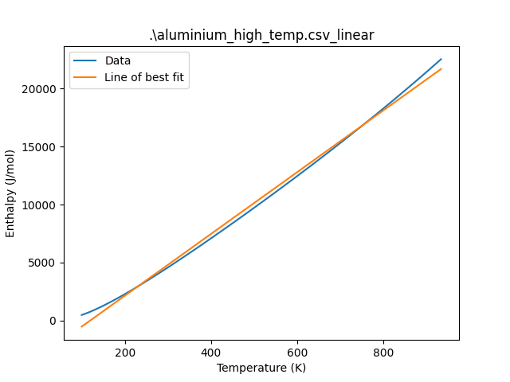
3. A linear fit
Two things should have been output:
A .png which looks like this
A .csv which contains some fit parameters (i.e. the mathematical equation for the line of best fit). You can open this in Notepad.

Slide 18
3. A linear fit - fit parameters
A .csv file contains “comma separated values”, so it’s a useful way to store data. Think of it like a table where the columns are separated by commas instead of a big line.
Our line of best fit is linear, so it’s got an equation of the form y = mx + c.
Can you calculate the heat capacity of Al based off the information from our fit?

Slide 19
3. A linear fit
For a linear equation, dH/dT will be constant (the gradient is always the same).
Here, the gradient m = 26.626.
So according to our model, c_{p} = 26.626 Jmol⁻¹K⁻¹.
In real life, c_{p} varies a decent bit from this (it’s 12.997 at 100K and 32.308 at 900K).

Slide 20
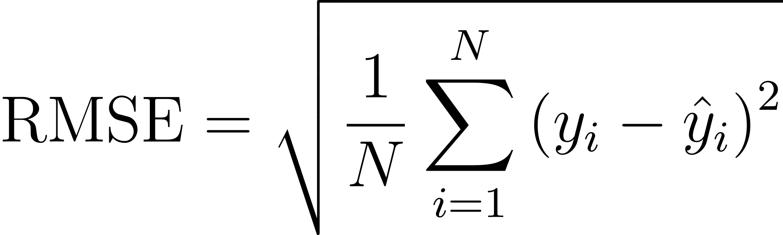
4. Comparing fits
Visually, we can evaluate roughly how good a fit is by seeing how close the lines look.
But if we want to make a comparison between similar looking fits, we need a quantitative measure of the error between the experimental data and our fit.
One way to do this is using the Root Mean Square Error (RMSE):
For each datapoint in our n datapoints, take the difference between our experimental enthalpy value and our “fit” enthalpy value and square it. Then take the average of those squares.

Slide 21
5. What about at low temp?
As we’ve seen, at high temperatures Kirchoff’s Law can be approximated to c = constant. This is because we can reasonably approximate that enthalpy increases linearly with temperature, so the gradient stays the same.
But what about at lower temperatures?
Try running the same linear fit on the dataset aluminium_low_temp.csv:
python plot.py aluminium_low_temp.csv linear

Slide 22
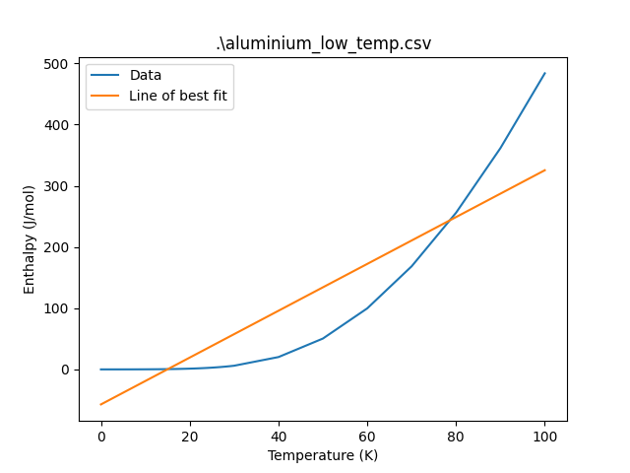
5. What about at low temp?
We’ve produced another linear line of best fit, but this time for aluminium at much lower temperatures.
Evaluate the fit. Is this linear graph a good fit to the raw data?
Is the MSE high or low?

Slide 23
6. Defining functions
A function is a piece of code that only runs when it is called (i.e. its name appears in the script). Python has loads of built-in functions which we use very often:
e.g. print(), which you’ve seen is a function that prints whatever's in the brackets.
We can write our own functions to do any task that gets repeated often in our code. Then whenever the task needs doing, we don't have to type out the same code all over again - we can just call the function!
This also makes our work more readable, because there's less redundant code.

Slide 24
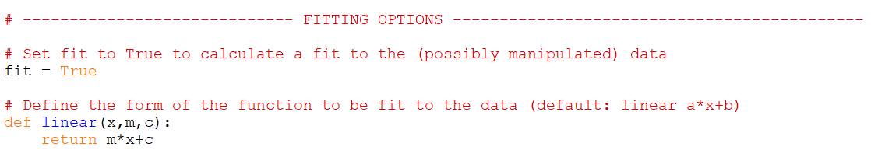
6. Defining functions
We want to define a new function which allows our script to fit the raw data to a graph with a different equation, like a quadratic or an exponential.
See if you can define a quartic function (of the form ax⁴ + bx³ + cx² + dx + e) in the script.

Slide 25
7. A new fit
Now we’re able to run the code again, using the name of our new function as an argument so our fit will hopefully be better.
Run plot.py with the new quartic fitting function, and see what the outputs are.

Slide 26
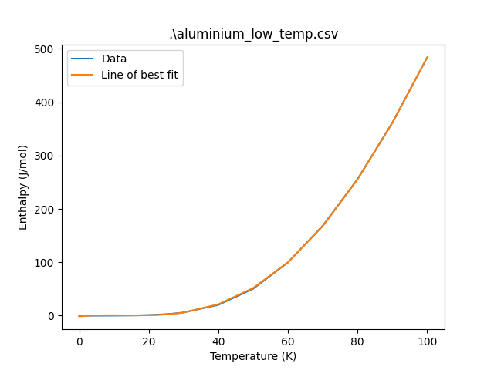
7. A new fit
How does the quality of this fit compare to the linear fit from earlier?
Using Kirchoff’s law and the fit parameters from this run, derive an equation that approximates the heat capacity of Al at temperatures below 100K.
What is c_{p} at 25K, according to this model?

Slide 27
7. A new fit
The equation for c_{p} should look approximately like this:
And the value for c_{p} at 25 K from this model is 0.473 Jmol⁻¹K⁻¹.
This isn’t too far off the literature value, which is 0.455 Jmol⁻¹K⁻¹.

Slide 28
8. What about noise?
The data we’ve been looking at so far has been pretty “clean”, there haven’t been any nasty outliers or any significant noise.
How does our approach to fitting data change when we’re working with noisy datasets?
Run the exact same code on the noisy low-temp Aluminium dataset that’s in the folder. Then derive an equation for the heat capacity from the temperature, exactly as before. How do they compare?

Slide 29
8. What about noise?
The new fit parameters should look something like this:
And your new function for c_{p} in terms of T, based off the model fitted to the noisy dataset:
This model predicts that at 25K, c_{p} = 0.802 Jmol⁻¹K⁻¹. This isn’t too far off, but it’s clear that the noise has distorted our results, increasing the error.

Slide 30
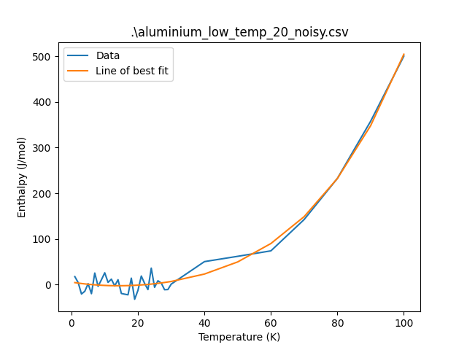
8. What about noise?
The quartic function still provides a good fit for the data’s trend, but doesn’t match the data precisely.
We can make the fitting function match the data better as it wobbles up and down.
Define a new function with many parameters, e.g. up to ax¹⁰. Run plot.py on the noisy data with the new function.

Slide 31
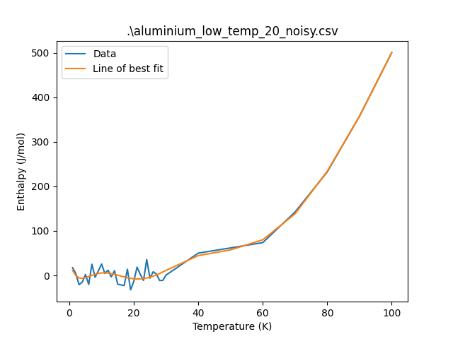
8. What about noise?
Is it a good idea to fit our curve to the lumps and bumps that the noise has caused?
Do we get a better prediction of the actual heat capacity using the more fitted curve?

Slide 32
9. Overfitting
No!
Experimental data is subject to all sorts of error during its collection.
The number that’s made it to your computer is not necessarily accurate, because more error leads to less precision.
We build models that predict values based off *trends* in the dataset as a whole, not individual data points.
Overfitting means we’d make a model that will only predict c accurately for the dataset it was fit to, and perform terribly when compared to other data.

Slide 33
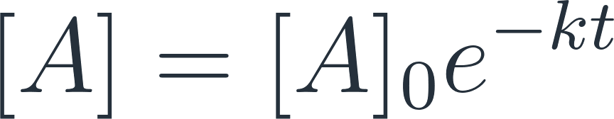
Extension
Last year you did some linear fitting to some first-order kinetics data. In that workshop you did that by linearising the equation below (taking the log of both sides) and then fitting a linear function to the data.
Now you have the tools you need to fit this data directly!
Download the kinetics data you used last year (kinetics.zip on the VLE), define an appropriate function, and use your Python script to fit the data to the equation above, and find a rate coefficient for each temperature.

Slide 34
Summary
Python can be a very valuable tool in analysis:
The use of computer scripts allows repetitive analysis to be carried out easily, in a consistent manner.
Collating results automatically minimises the risk of errors from manual transcription.
We can get a line of best fit and use that as a model to predict properties.
Don’t overfit your data.

